Slide 1
Upcoming
Monday: Homework 2 due
If you would like to present early, you can
Wednesday: Diffraction Show and Tell. Bring some printouts to show. Can make copies in 111 if needed.
Friday: Test 1 (in class), bring notes sheet
Monday (Sept 19): Guest speaker from DoD

Slide 2

Group: Find the structure factor and extinctions for FCC.
Notes:
Draw on board f*[1 + (-1) ^(h+k) + (-1)^ (k+l) + (-1)^ (h+l)] What rules can we develop? If having trouble, try picking some planes. Note that there is a lot of symmetry so the 100 and 001 will give same result, as would 110 to 011, and so on.

Slide 3
Group: Find the structure factor and extinctions for FCC.
Notes:
Draw on board f*[1 + (-1) ^(h+k) + (-1)^ (k+l) + (-1)^ (h+l)] What rules can we develop? If having trouble, try picking some planes. Note that there is a lot of symmetry so the 100 and 001 will give same result, as would 110 to 011, and so on.

Slide 4
Group: Find the structure factor and extinctions for FCC.
Notes:
Draw on board f*[1 + (-1) ^(h+k) + (-1)^ (k+l) + (-1)^ (h+l)] What rules can we develop? If having trouble, try picking some planes. Note that there is a lot of symmetry so the 100 and 001 will give same result, as would 110 to 011, and so on.

Slide 5
Group: Find the structure factor for FCC.
002
022
202
Allowed low order reflections are:
  111, 200, 220, 311, 222, 400, 331, 310
Forbidden reflections:
  100, 110, 210, 211
000
111
020
200
220
Notes:
If having trouble figuring out the rules, use the trick we learned for BCC.

Slide 6
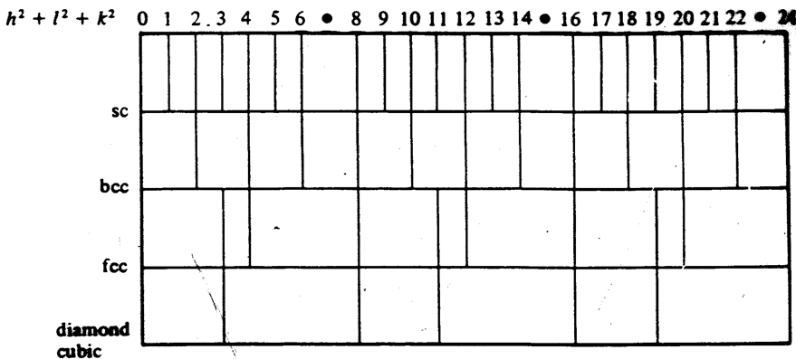
Allowed Diffraction Peaks
(See a trend?)
How can you tell them apart by peak position?
More lattice points in conventional cell → less peaks
2
3
4
5
6
8
2
3
4
5
6
7
4
/
3
8/3
11
/
3
16
/
3
19
/
3
4
Notes:
If you are reading this, please say so in your homework question on the structure factor. I’d just like to know if anyone is paying close attention to these notes. Thanks! ☺
Discuss the simple cubic and the planes the lines refer to: 100, 110, 111, 200, 210, 211, 220, 221…families of planes
The correct angular separations are not reproduced in this diagram.
You have to go out pretty fair to tell between bcc and sc. (Though, note that the only single element material to form in sc is polonium.) Most single basis crystals are bcc, fcc or hcp.

Slide 7
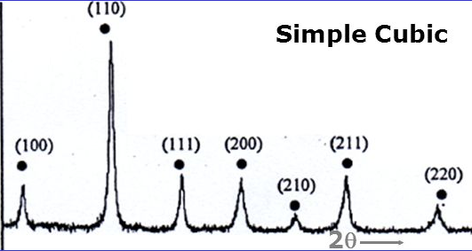
What did we get for the structure factor of simple cubic?
How would you expect the intensity of the peaks to compare?
Intensity (arbitrary units)
Why might the intensities not be the same?
Notes:
Why aren’t all of the peaks the same intensity? One reason is that there is more than one atom in the basis.
(Another contributing reason could be the form factor effect with angle, which we will discuss qualitatively later.)

Slide 8
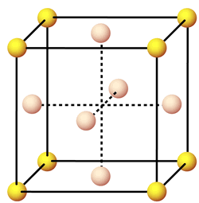
When more than one element
Ni₃Al Nickel aluminide structure, what structure is it?
Al
Ni

Slide 9
When more than one element
Ni₃Al Nickel aluminide structure, what is it?
Al
Ni
Simple cubic lattice, with a four atom basis
( )

Slide 10
When more than one element
Ni₃Al Nickel aluminide structure, what is it?
Al
Ni
Simple cubic lattice, with a four atom basis
( )

Slide 11
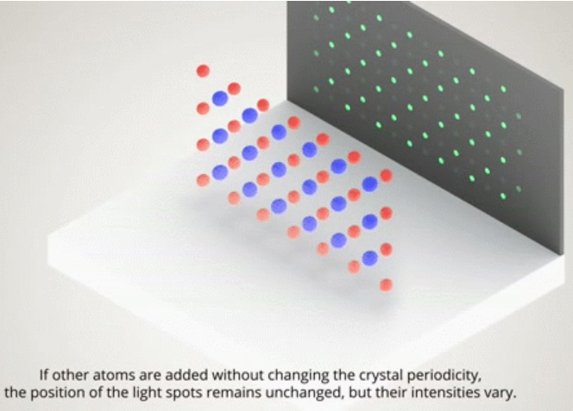
When more than one element
Ni₃Al Nickel aluminide structure, what is it?
Al
Ni
Simple cubic lattice, with a four atom basis
( )
Again, since simple cubic, intensity at all points.
But each point is ‘chemically sensitive’.

Slide 12
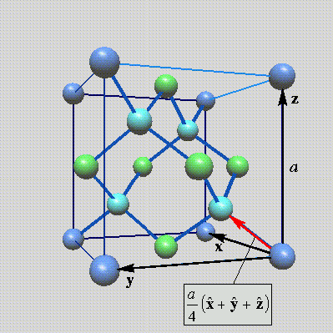
What Would You Expect for Diamond?
Calculate the structure factor for the diamond structure. Lattice = FCC.
Primitive Basis = (000), (¼ ¼ ¼)
Very similar to your homework
I expect you to show your work to calculate the structure factor. Obviously you can check your answers with published work, but I want to make sure you can do it.
Notes:
I typically either assign this for homework or GaAs
If time, discuss how to approach the basis using a conventional cell. Again, it’s possible to do this with primitive lattice vectors, but the math is a little harder which makes it easier to make mistakes.

Slide 13
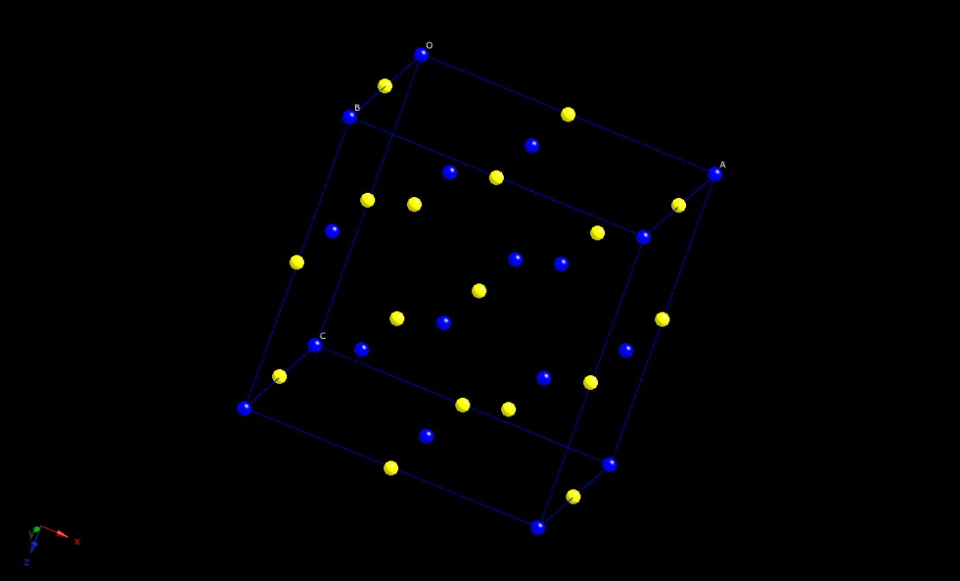

Structure Factor with Different Atoms
NaCl (rock salt) structure
FCC 1 atom Reminder:
Notes:
Depending on time, don’t make them do, but get them to think about
Similar to diamond, except this time with different atoms.
Due to this intensity depending on the atoms, we often say this is chemically (or elementally) sensitive

Slide 14
Structure Factor with Different Atoms
NaCl (rock salt) structure
FCC 1 atom Reminder:
Notes:
Don’t make them do, but get them to think about
Similar to diamond, except this time with different atoms.
Due to this intensity depending on the atoms, we often say this is chemically (or elementally) sensitive

Slide 15
Structure Factor with Different Atoms
NaCl (rock salt) structure
FCC 1 atom Reminder:
Notes:
Don’t make them do, but get them to think about
Similar to diamond, except this time with different atoms.
Due to this intensity depending on the atoms, we often say this is chemically (or elementally) sensitive

Slide 16
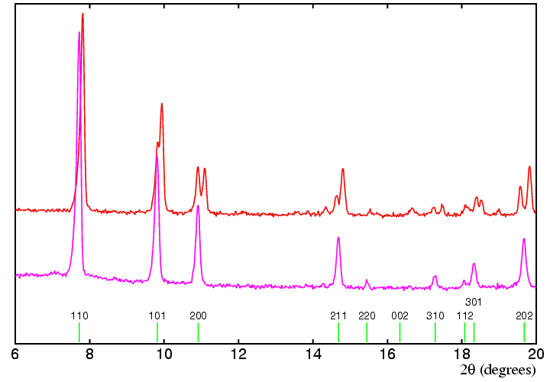
Common to see an average decrease in intensity of the diffraction peaks despite rules for peak intensities

Slide 17
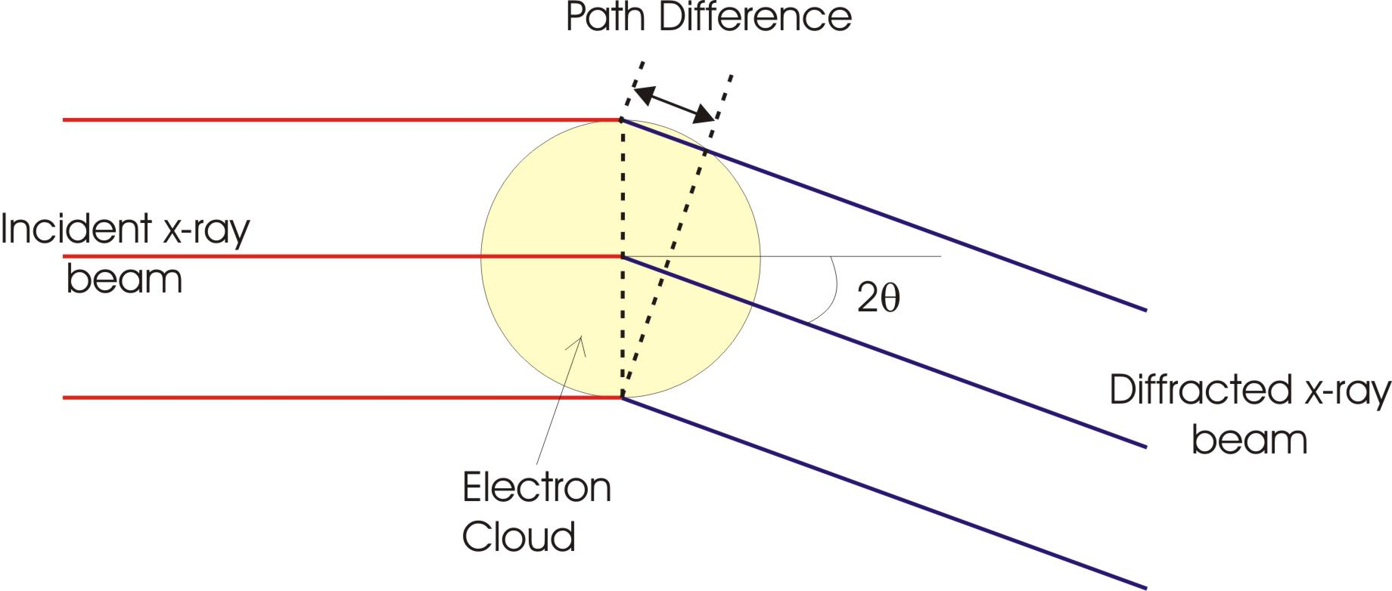
Atomic Form Factor f (key points)
(aka Scattering Factor)
Atoms are of a comparable size to the wavelength of the x-rays and so the scattering is not point like. There is a small path difference between waves scattered at either side of the electron cloud
This effect increases with angle
For x-rays, scattering strength depends on electron density
All electrons in atom (Z of them) participate, core e⁻ density ~spherical
Also, thermal effects increase the effective size of atom
Only at 2θ=0 does f=Z
Notes:
I could go into this in much more detail, but doesn’t seem necessary or particularly useful. I don’t test anything quantitively in this section, though I would expect you to be able to explain why the intensities we get from the structure factor aren’t exactly what’s observed. Computer analysis of diffraction will factor this in before giving the predicted intensities.
Possibly compare to neutron diffraction, where you don’t see this effect

Slide 18
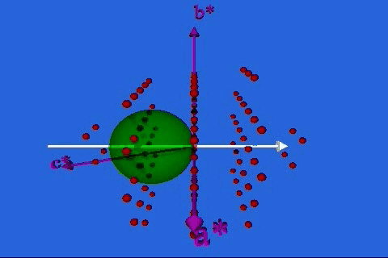
Ewald Sphere
But do you have a detector in the right place to detect the peak?
http://www.doitpoms.ac.uk/tlplib/reciprocal_lattice/ewald.php
http://www.physics.byu.edu/faculty/campbell/animations/x-ray_diffraction.html

Slide 19
THE EWALD SPHERE (Will show a few ways)
Consider an arbitrary sphere
passing through the reciprocal lattice (which we will define soon),
with the crystal arranged in the center of the sphere.
We specify two conditions:
the sphere radius is 2π /λ - the inverse wavelength of X-ray radiation
the origin of the reciprocal lattice lies on the surface of the sphere
X-rays are ON
diffracted ray
2θ
O
2π/λ
The diffraction spot will be observed when a reciprocal lattice point crosses the Ewald sphere
Notes:
Sometimes you’ll see this as just one over lambda (dropping the 2 pi), when reciprocal lattice also drops 2 pi
At this point, the Bragg condition is said to be satisfied
I personally don’t like the Ewald sphere, but a lot of researchers think it’s the best way to understand diffraction points, so I feel I should at least show it.
So far it looks easy enough, but it gets more confusing because you have to rotate the sphere.

Slide 20
1. Longitudinal or θ-2θ scan
Sample moves as θ, Detector follows as 2θ
k₀
k’

Slide 21
1. Longitudinal or θ-2θ scan
Sample moves on θ, Detector follows on 2θ
G
k₀
k’
Reciprocal lattice rotates by θ during scan

Slide 22
1. Longitudinal or θ-2θ scan
Sample moves on θ, Detector follows on 2θ
G
k₀
k’
2θ

Slide 23
1. Longitudinal or θ-2θ scan
Sample moves on θ, Detector follows on 2θ
G
k₀
k’
2θ

Slide 24
1. Longitudinal or θ-2θ scan
Sample moves on θ, Detector follows on 2θ
G
k₀
2θ
k’

Slide 25
1. Longitudinal or θ-2θ scan
Sample moves on θ, Detector follows on 2θ
G
k₀
k’
2θ

Slide 26
1. Longitudinal or θ-2θ scan
Sample moves on θ, Detector follows on 2θ
k’
k₀
G
2θ
Provides information about relative arrangements, angles, and spacings between crystal planes.

Slide 27
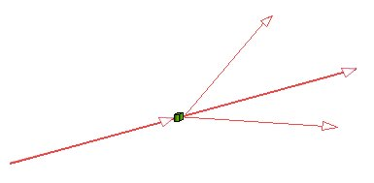
If a monochromatic x-ray beam is directed at a single crystal, then only one or two diffracted beams may result.
The Powder Method

Slide 28
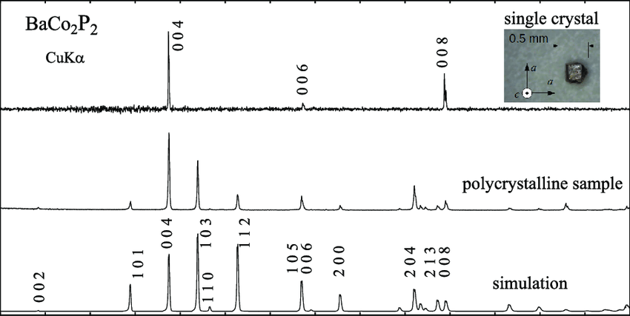
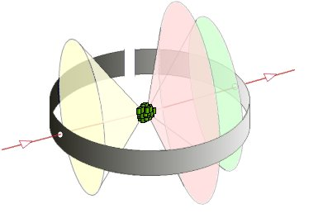
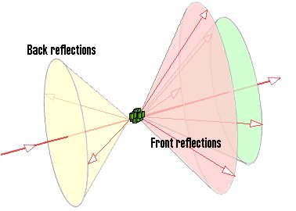
The Powder Method
Thus, a polycrystalline material will have more peaks, because one of those crystal lattice in the sphere will line up with the detector.
If the sample consists of some tens of randomly orientated single crystals, the diffracted beams are seen to lie on the surface of several cones.
The cones may point both forwards and backwards.

Slide 29
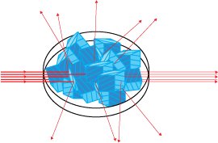
THE POWDER METHOD
Least crystal information needed ahead of time
If a powder is used, instead of a single crystal, then there is no need to rotate the sample, because there will always be some crystals at an orientation for which diffraction is permitted.
A monochromatic X-ray beam is incident on a powdered or polycrystalline sample.
Notes:
Common method if you don’t know much about your material (or if you already have it in powder form).

Slide 30
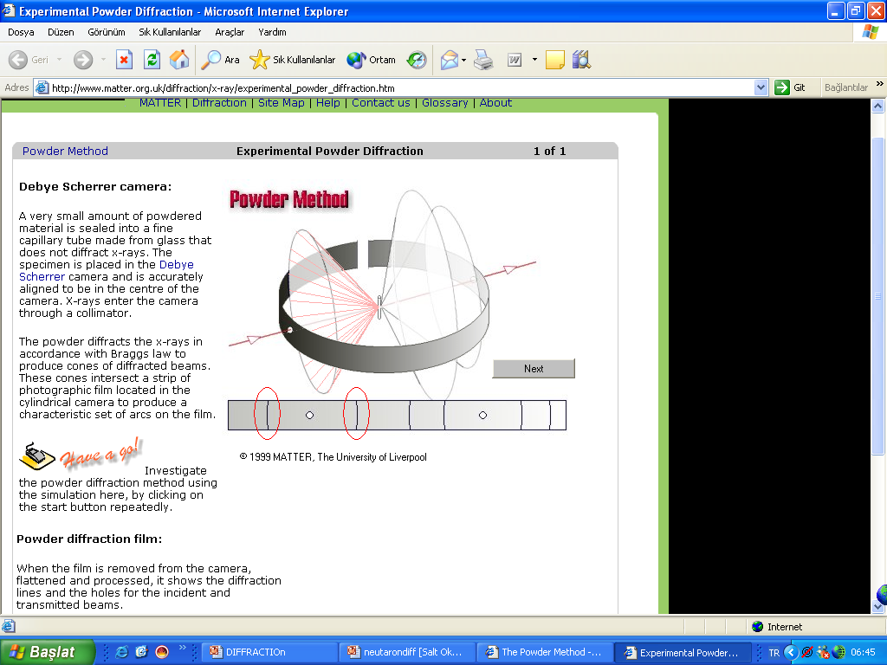
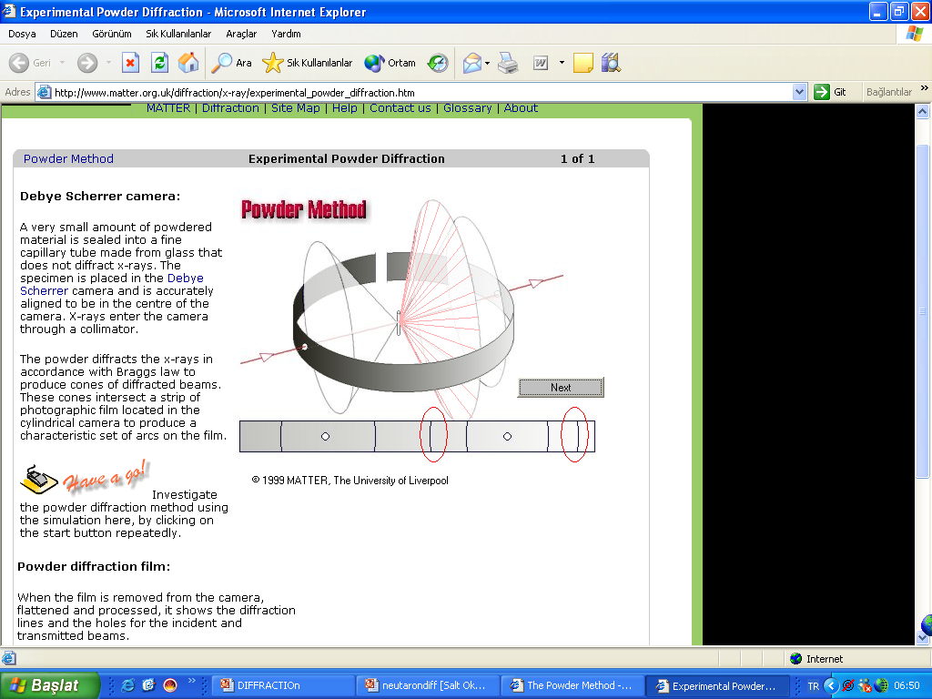
A sample of some hundreds of crystals (i.e. a powdered sample) show that the diffracted beams form continuous cones.
A circle of film or rotating detector is used to record the diffraction pattern as shown.
Each cone intersects the film giving diffraction arcs.
The Powder Method

Slide 31
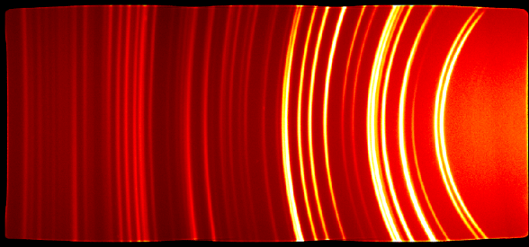
Powder diffraction film
When the film is removed from the camera, flattened and processed, it shows the diffraction lines and the holes for the incident and transmitted beams. Likewise, detectors can show the same thing.

